Slide 1
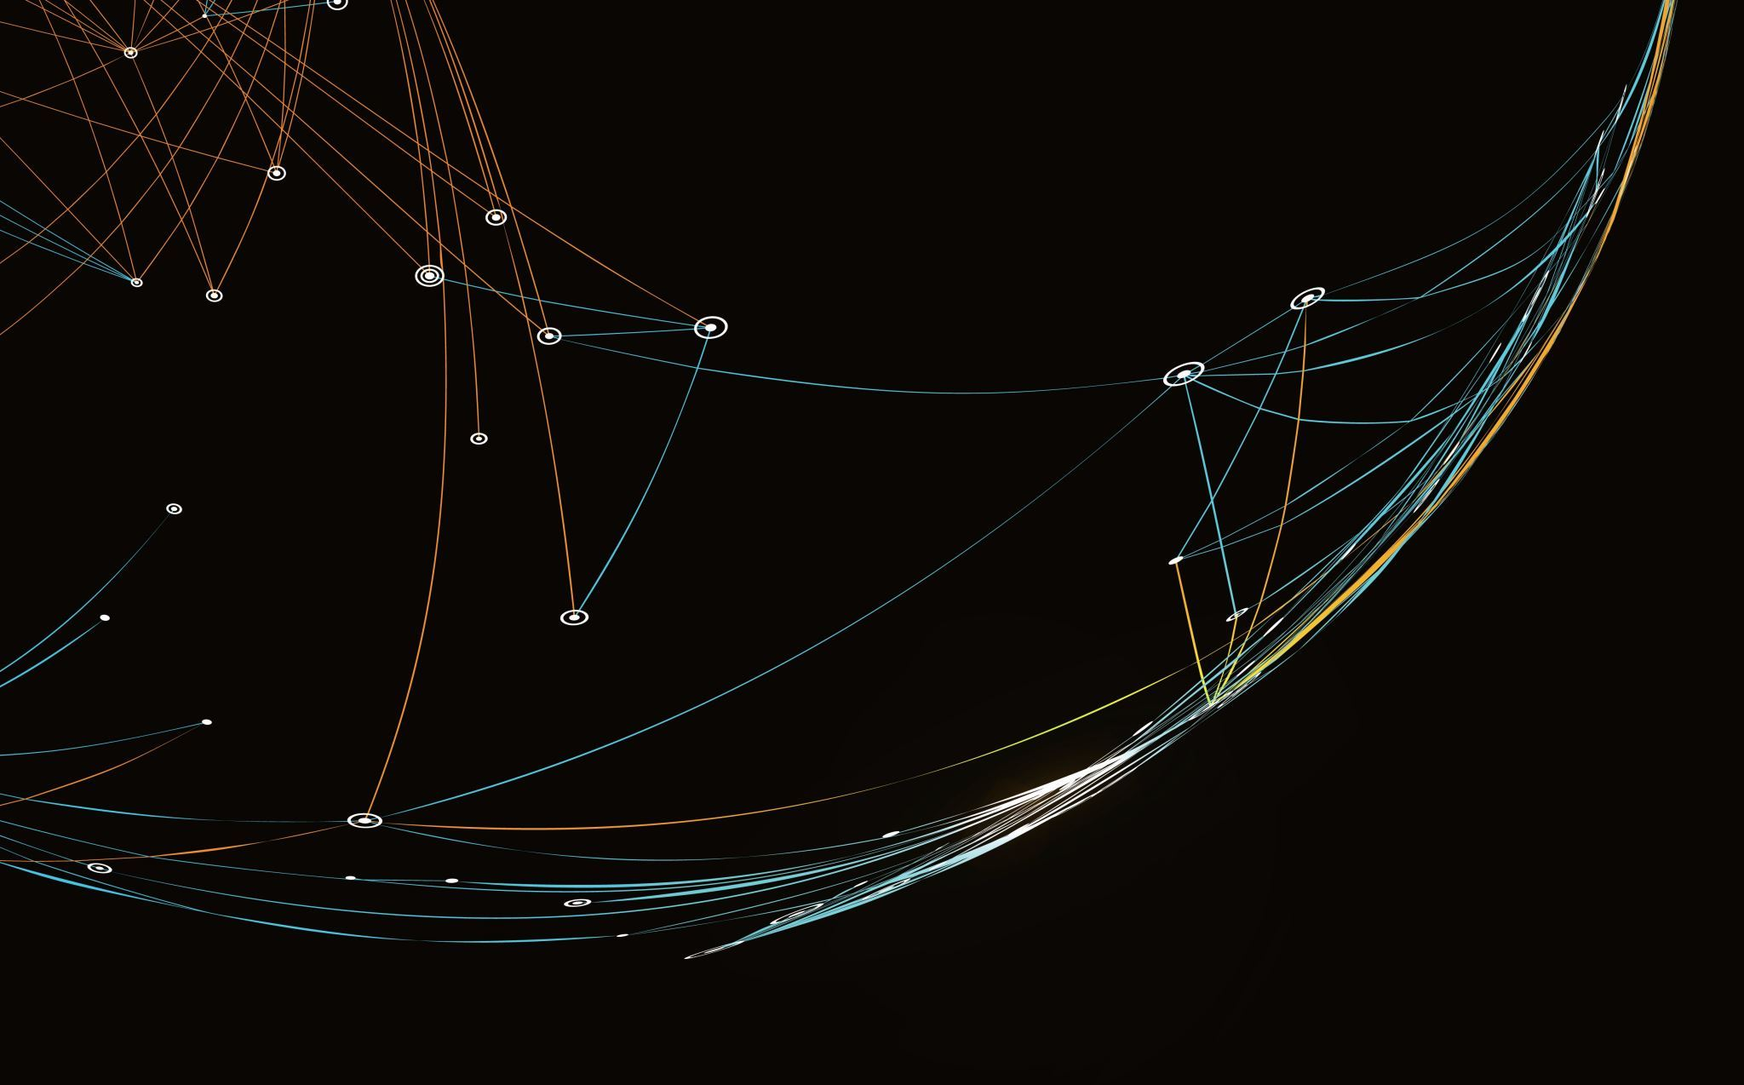
Zero Trust
Genesis Grant
Honors Contract Project
CTEC 345

Slide 2
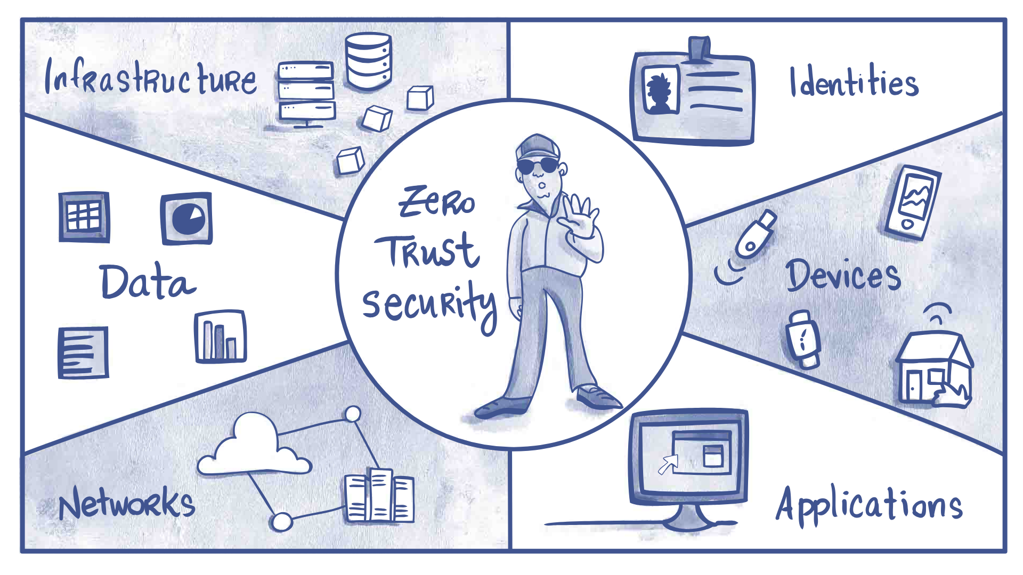
What is Zero Trust?
Zero trust is the strategy that no one in the network is to be trusted or given universal access and the network is always at risk. Users must go through multiple authentication processes, policies, access restrictions, etc. in order to mitigate any possible vulnerabilities.
In this concept, trust is treated as a vulnerability.

Slide 3
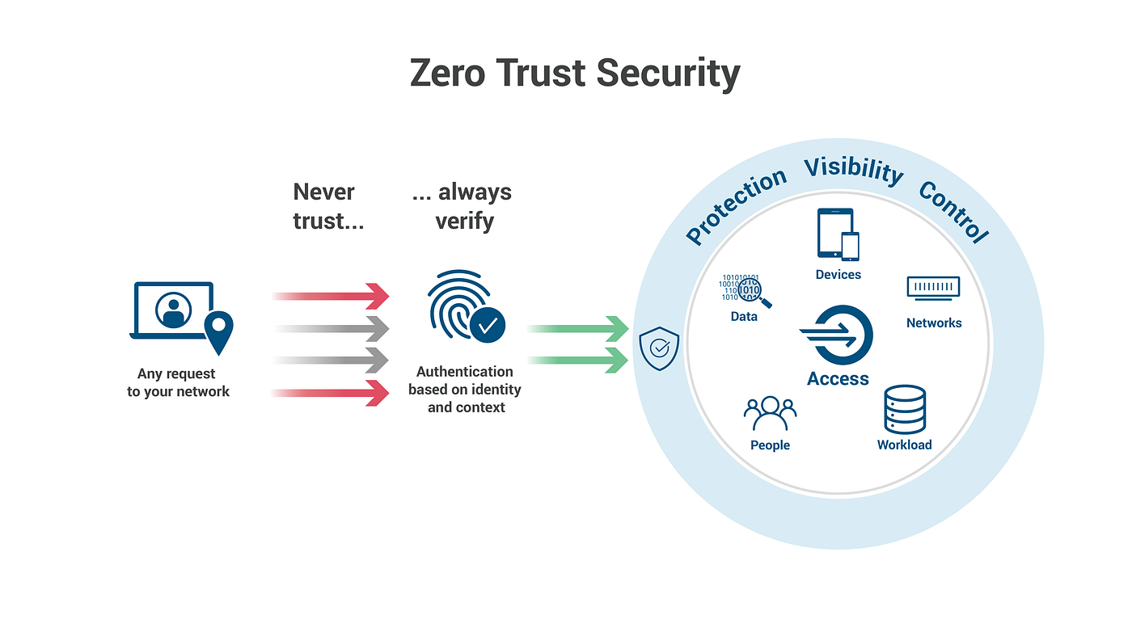
Zero Trust Architecture
Within the network, identify which structures, data, applications, etc. that the client deems critical and wishes to thoroughly protect (i.e. protect surface/perimeter).
Analyze traffic within the chosen protect surface including, but not limited to, users within the network, their activity, how they are connected, applications being used, etc.
Utilize techniques, policies, and layer defenses to protect surface and prevent adversaries from taking advantage of possible vulnerabilities. This will vary dependent upon the nature of each protect surface (business goals or purpose, company size, number of devices, etc.).

Slide 4
Zero Trust Background
Traditional networks implemented idea of default trust, where once in the network you are given access to the full network. Modern technology has advanced to remote work, adversaries easily gaining access to corporate networks, advancements in the cloud, etc., thus proving a need for more security control within networks.
Zero trust automatically assumes that all users must be authenticated, even after verified the user is given limited access and privileges.
“Never trust, always verify”
Enforces access based on context; if user changes location, level of data being accessed, permissions requesting to be accessed, etc.
Micro segmentation: separating one large network into multiple different subnetworks/zones based on level of secure access.
To move throughout zones, reauthentication required and security policies based on zone enforced.
Privileges given only to complete necessary duties, users are monitored (network connections, activity, etc.) from very point of access.

Slide 5
Zero Trust Software
Zscaler Zero Trust Network Access (ZTNA): Used as a network gateway, in order for users to have access to network capabilities and applications they first must undergo multifactor authentication. Allows for secure remote access, companies are able to see network traffic, and enforces policies based on user roles, context, etc.
Microsoft Bitlocker: Encryption tool used to mitigate potential theft of data within a system. Bitlocker can be unlocked through a unique key only known to administrator.
Google Authenticator: A multi-factor authentication tool utilized to add another layer of protection. The application will randomly come up with a unique code that will be used with your personal password to authenticate users.
Imperva Web Application Firewall (WAF): Firewall that is used within a web browser in order to monitor and/or requests and traffic. Imperva is unique as it utilizes machine learning to gather data on patterns within network traffic and mitigate any possible attacks.
**Companies are able to use multiple software in order to stack protection against adversaries. Stacking software can help companies keep track of multiple analytics, if one defense goes down there is another still working to protect the network, as well as different software may be more beneficial dependent on the context and needs of the company.

Slide 6
References
What is Zero Trust? | IBM. (n.d.). https://www.ibm.com/topics/zero-trust
Mjcaparas. (2023, June 14). What is Zero Trust? Microsoft Learn. https://learn.microsoft.com/en-us/security/zero-trust/zero-trust-overview
Zscaler. (n.d.). 7 elements of Highly successful Zero Trust architecture | Video - ZScaler [Video]. Zscaler. https://www.zscaler.com/resources/security-terms-glossary/what-is-zero-trust
Implementing a zero trust architecture | NCCOE. (2023, August 22). NCCoE. https://www.nccoe.nist.gov/projects/implementing-zero-trust-architecture
SailPoint Technologies. (n.d.). Zero Trust & Micro-Segmentation Explained | SailPoint. SailPoint. https://www.sailpoint.com/identity-library/zero-trust-micro-segmentation/
Witts, J. (2023). The top 10 Zero trust security solutions. Expert Insights. https://expertinsights.com/insights/the-top-10-zero-trust-security-solutions/

